Slide 1
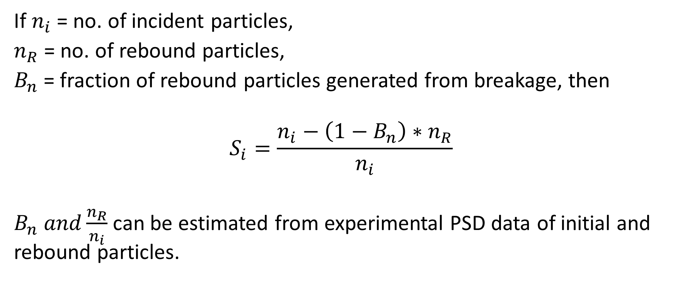

How to calculate breakage probability $S_{i}$?
If $n_{i}$= no. of incident particles,
$n_{R}$= no. of rebound particles,
$B_{n}$= fraction of rebound particles generated from breakage, then
$$S_{i}=\frac{n_{i}−\left(1−B_{n}\right)∗n_{R}}{n_{i}}$$
$B_{n} and\frac{n_{R}}{n_{i}}$ can be estimated from experimental PSD data of initial and rebound particles.

Slide 2
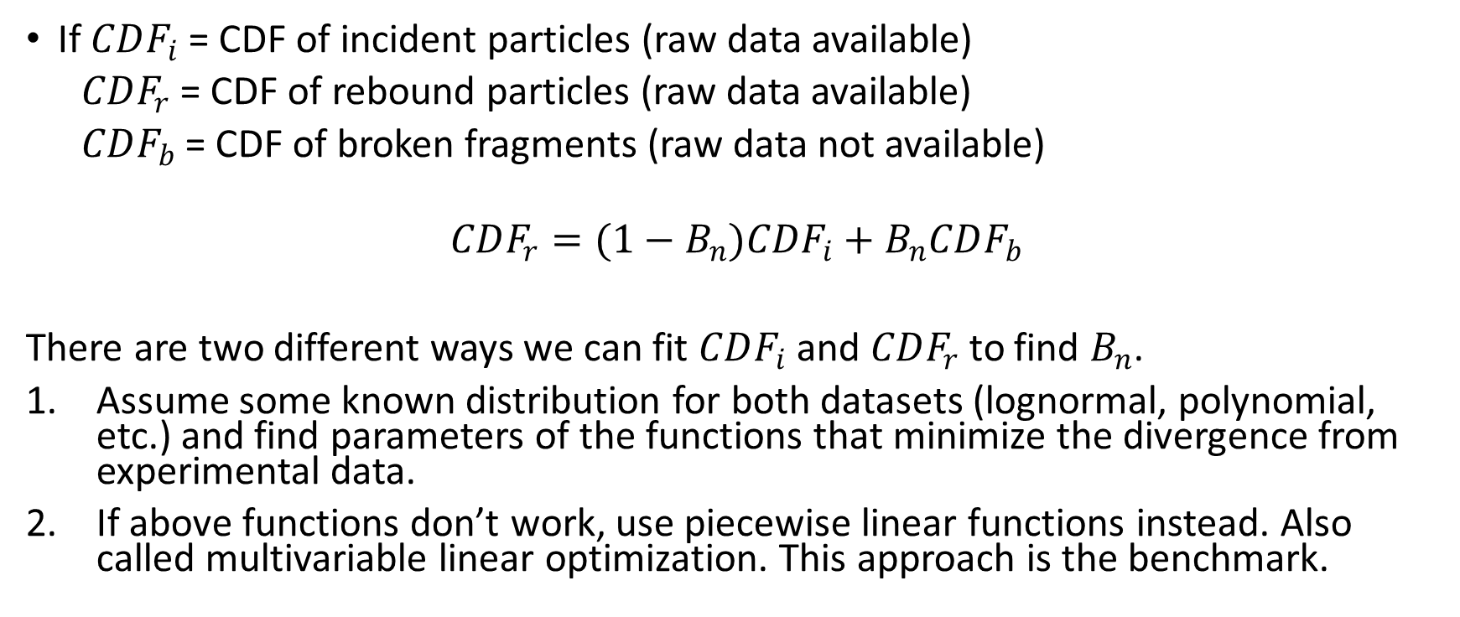

Method to estimate $B_{n}$ from expt. data
If $CDF_{i}$ = CDF of incident particles (raw data available)
$CDF_{r}$ = CDF of rebound particles (raw data available)
$CDF_{b}$ = CDF of broken fragments (raw data not available)
$$CDF_{r}=(1−B_{n})CDF_{i}+B_{n}CDF_{b}$$
There are two different ways we can fit $CDF_{i}$ and $CDF_{r}$ to find $B_{n}$.
Assume some known distribution for both datasets (lognormal, polynomial, etc.) and find parameters of the functions that minimize the divergence from experimental data.
If above functions don’t work, use piecewise linear functions instead. Also called multivariable linear optimization. This approach is the benchmark.

Slide 3




Multivariable linear optimization
$$CDF_{i}$$
$$CDF_{r}$$
$$CDF_{b}$$
diameter
diameter
diameter
Initial PSD
Rebound PSD
Broken PSD
$$CDF_{r}′=(1−B_{n})CDF_{i}+B_{n}CDF_{b}$$
function f = $Σ\left(CDF_{r}^{′}−CDF_{r}\right).^2$

Slide 4
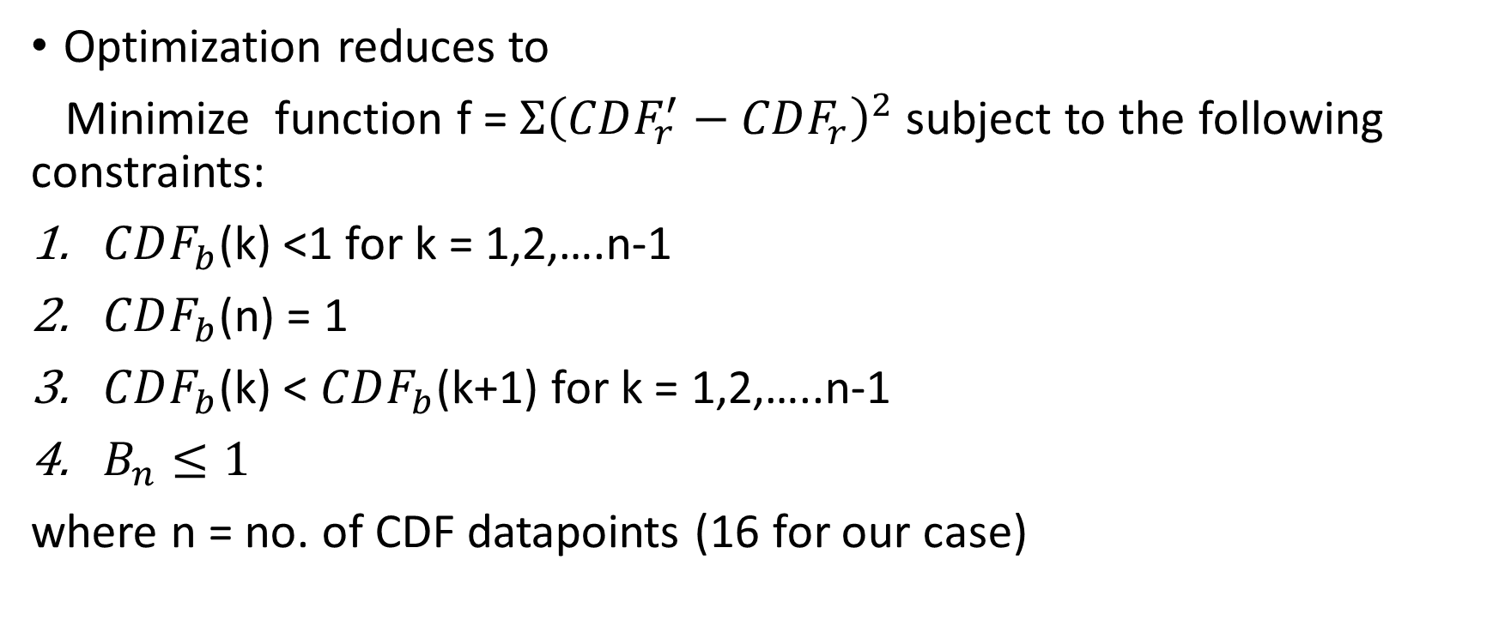
Multivariable linear optimization (Contd)
Optimization reduces to
Minimize function f = $Σ{\left(CDF_{r}^{′}−CDF_{r}\right)}^{2}$ subject to the following constraints:
$CDF_{b}$(k) <1 for k = 1,2,….n-1
$CDF_{b}$(n) = 1
$CDF_{b}$(k) < $CDF_{b}$(k+1) for k = 1,2,…..n-1
$B_{n}≤1$
where n = no. of CDF datapoints (16 for our case)

Slide 5
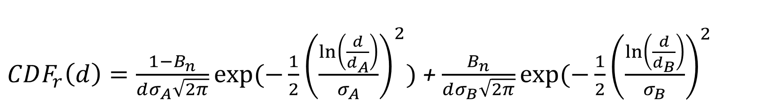
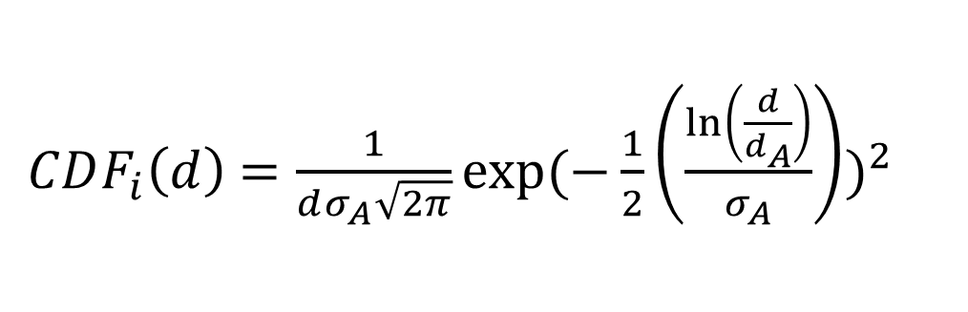
Lognormal fitting
$$CDF_{r}=(1−B_{n})CDF_{i}+B_{n}CDF_{b}$$
$CDF_{i}\left(d\right)$ $=\frac{1}{dσ_{A}\sqrt{2π}}exp⁡(−\frac{1}{2}{\left(\frac{\ln\left(\frac{d}{d_{A}}\right)}{σ_{A}}\right))}^{2}$
$CDF_{r}\left(d\right)=\frac{1−B_{n}}{dσ_{A}\sqrt{2π}}exp⁡(−\frac{1}{2}{\left(\frac{\ln\left(\frac{d}{d_{A}}\right)}{σ_{A}}\right)}^{2})$ + $\frac{B_{n}}{dσ_{B}\sqrt{2π}}exp⁡(−\frac{1}{2}{\left(\frac{\ln\left(\frac{d}{d_{B}}\right)}{σ_{B}}\right)}^{2}$

Slide 6
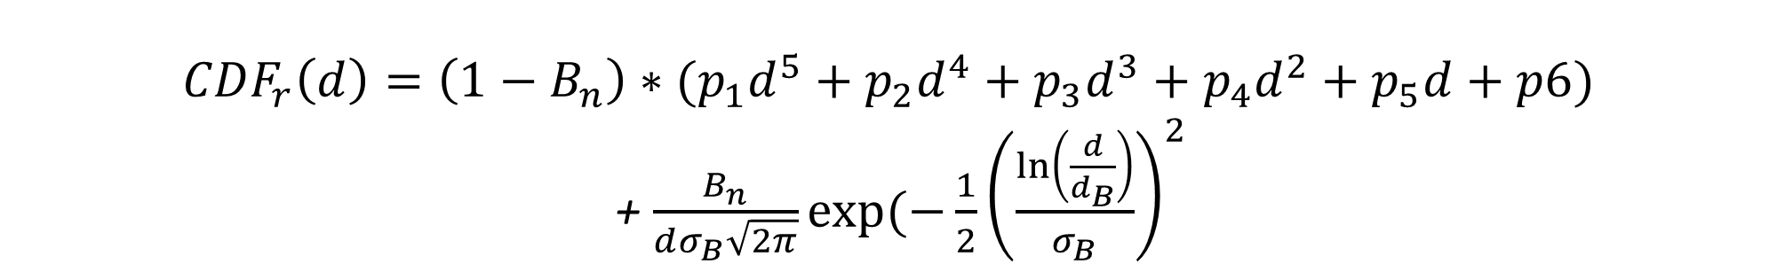
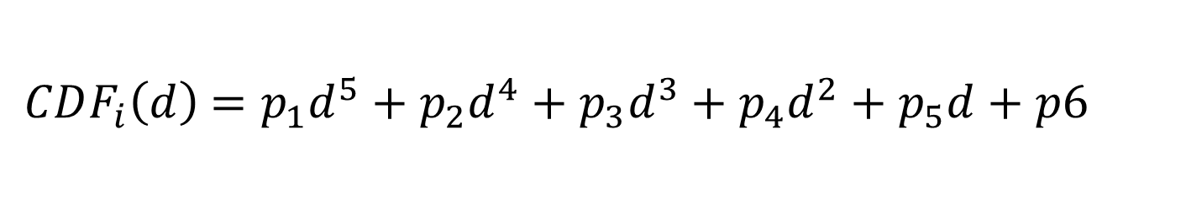

(Lognormal + Polynomial) fitting
$$CDF_{r}=(1−B_{n})CDF_{i}+B_{n}CDF_{b}$$
$CDF_{i}\left(d\right)$ $=p_{1}d^{5}+p_{2}d^{4}+p_{3}d^{3}+p_{4}d^{2}+p_{5}d+p6$
$$CDF_{r}\left(d\right)={\left(1−B_{n}\right)∗(p}_{1}d^{5}+p_{2}d^{4}+p_{3}d^{3}+p_{4}d^{2}+p_{5}d+p6)$$
+ $\frac{B_{n}}{dσ_{B}\sqrt{2π}}exp⁡(−\frac{1}{2}{\left(\frac{\ln\left(\frac{d}{d_{B}}\right)}{σ_{B}}\right)}^{2}$

Slide 7

Piecewise linear fitting
$$CDF_{i}$$
$$CDF_{r}$$
diameter
diameter
Initial PSD
Rebound PSD
$$CDF_{r}=(1−S_{i})CDF_{i}+S_{i}CDF_{b}$$

Slide 8
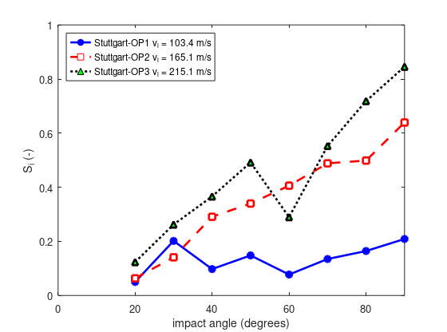
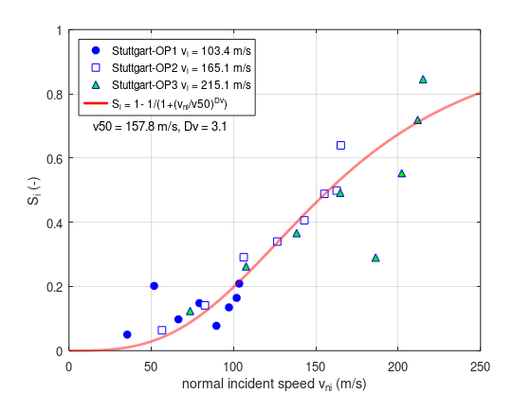
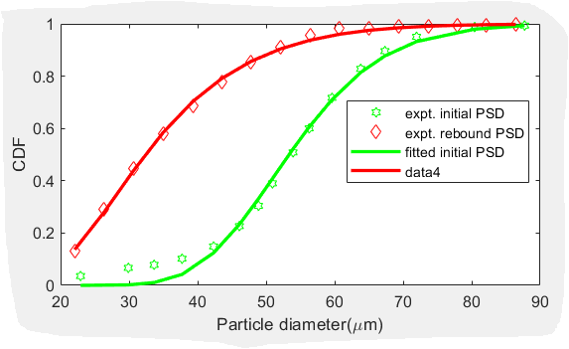
Approach A
Incident: log-normal fitting
Rebound: log-normal fitting

Slide 9
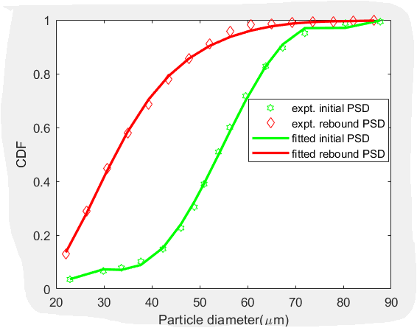
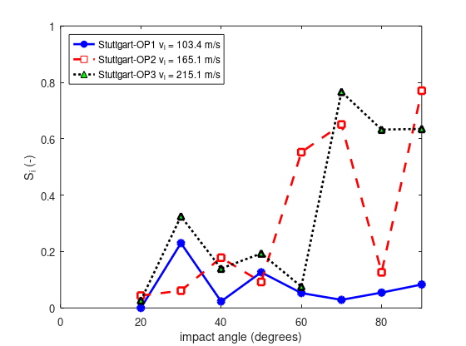
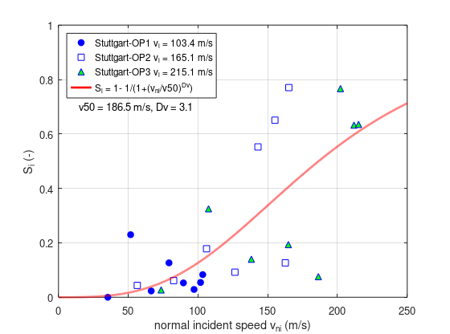
Approach B
Incident: 5-order polynomial fitting
Rebound: log-normal fitting

Slide 10
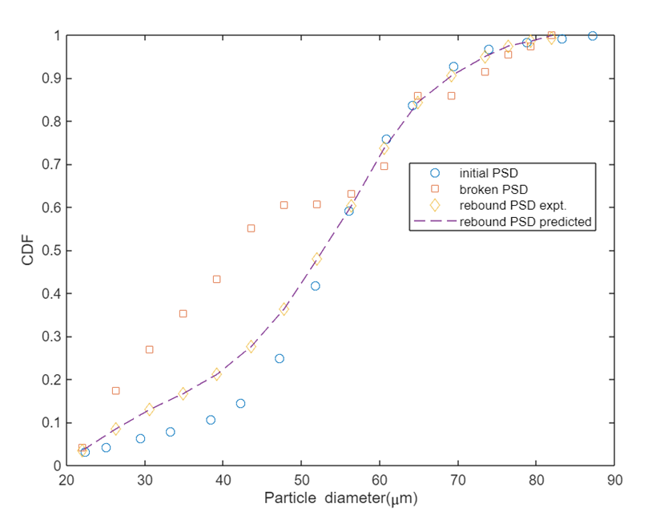
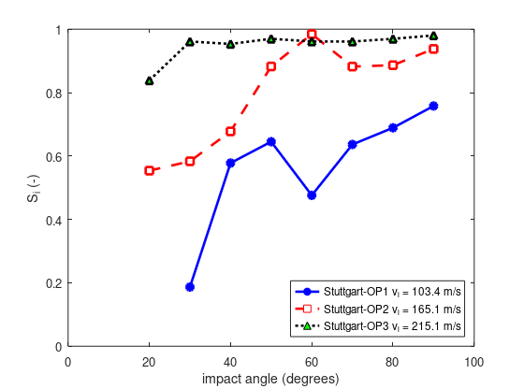
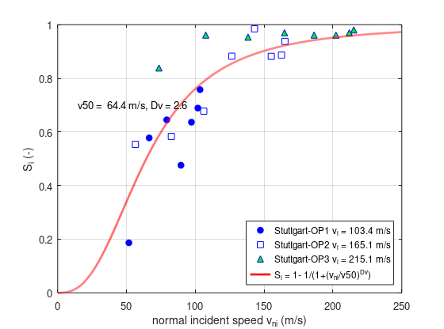
Approach C
Incident: piecewise linear
Rebound: piecewise linear
Typical optimization results
V = 103.4 m/s
= 30º
B_{n} = 0.324

Slide 11
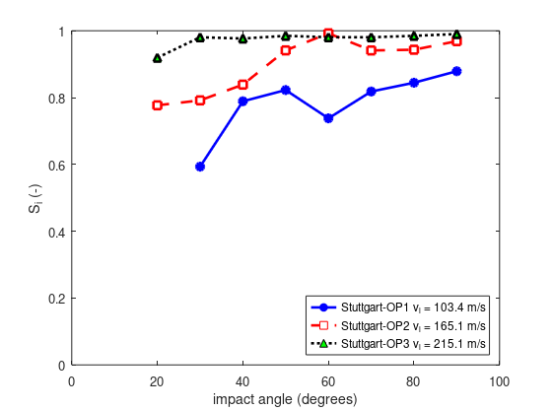
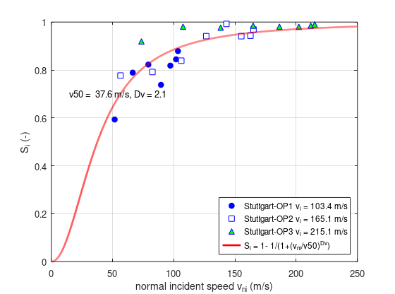
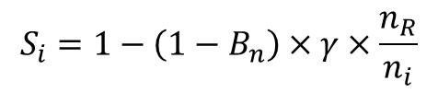
Approach C – consider the mass loss to invisible rebound particles
Incident: piecewise linear
Rebound: piecewise linear
volume of visible particle
volume of incident
= γ = 1.0
volume of visible particle
volume of incident
= γ = 0.5
$$S_{i}=1−\left(1−B_{n}\right)×γ×\frac{n_{R}}{n_{i}}$$

Slide 12
Backup data – piecewise linear CDF of incident, rebound, and broken particles

Slide 13
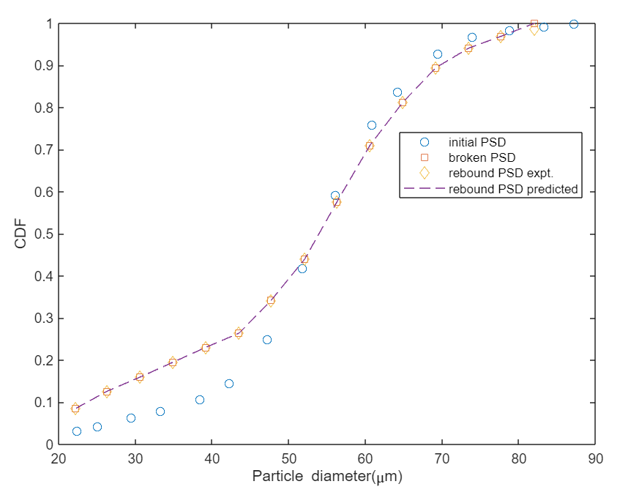
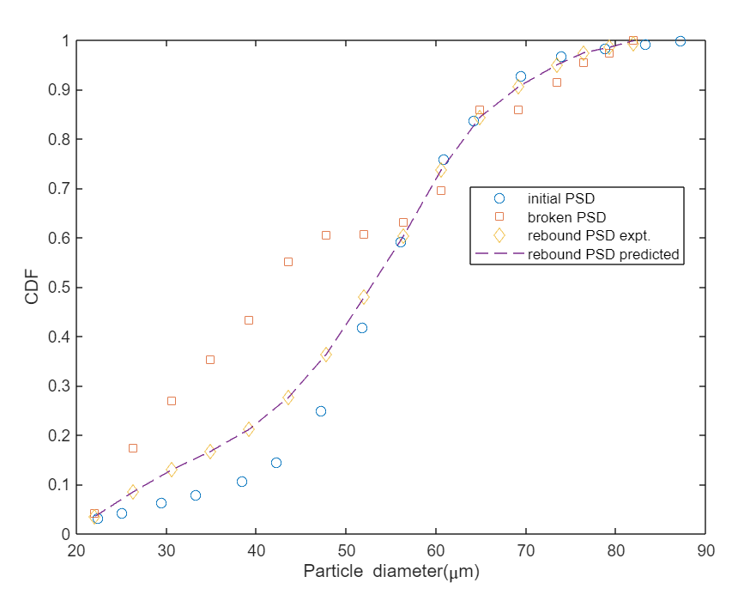
Results of predicted PSD
Speed OP1, angle 20 degrees
Speed OP1, angle 30 degrees

Slide 14
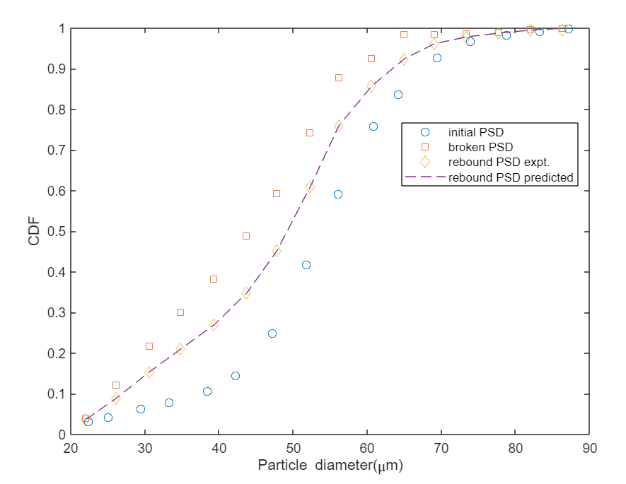
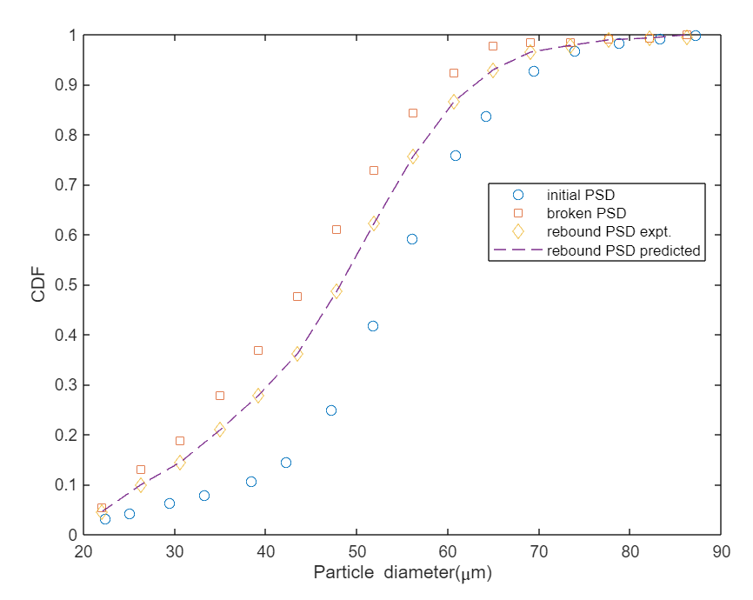
Results of predicted PSD
Speed OP1, angle 40 degrees
Speed OP1, angle 50 degrees

Slide 15
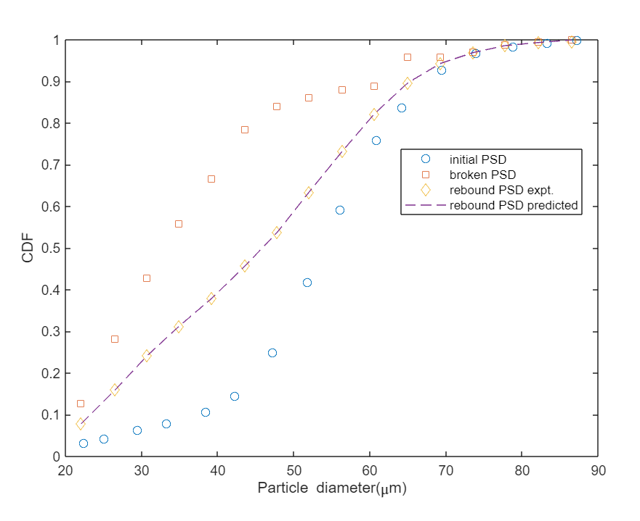
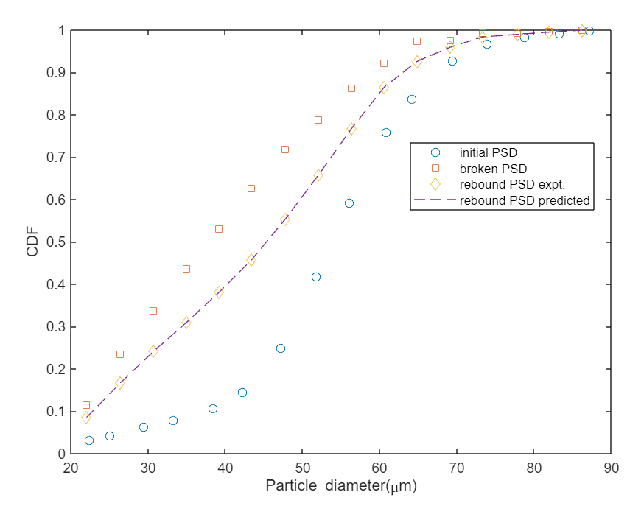
Results of predicted PSD
Speed OP1, angle 60 degrees
Speed OP1, angle 70 degrees

Slide 16
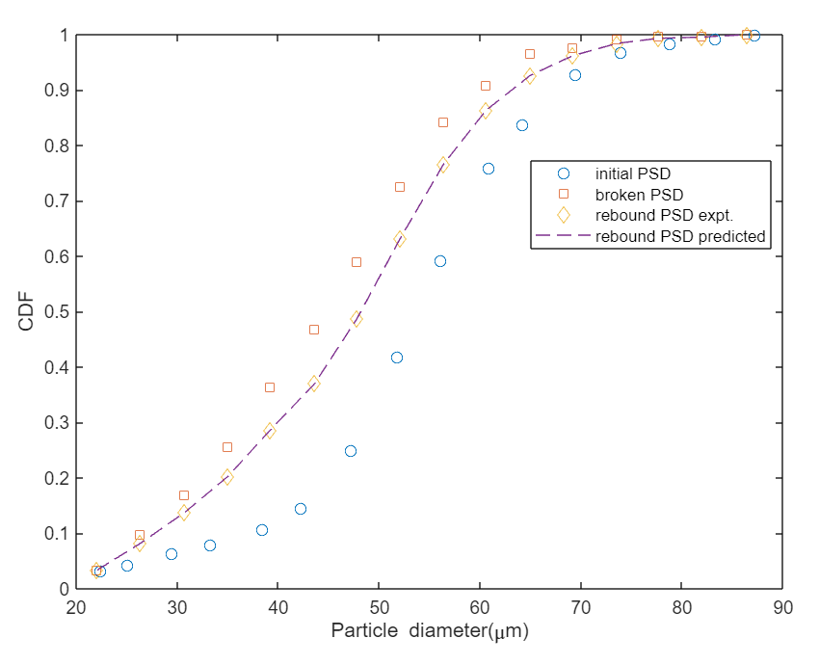
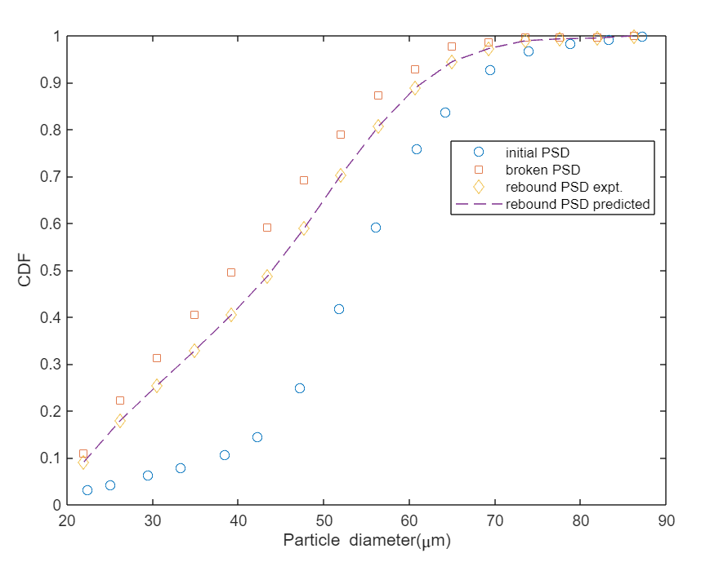
Results of predicted PSD
Speed OP1, angle 80 degrees
Speed OP1, angle 90 degrees

Slide 17
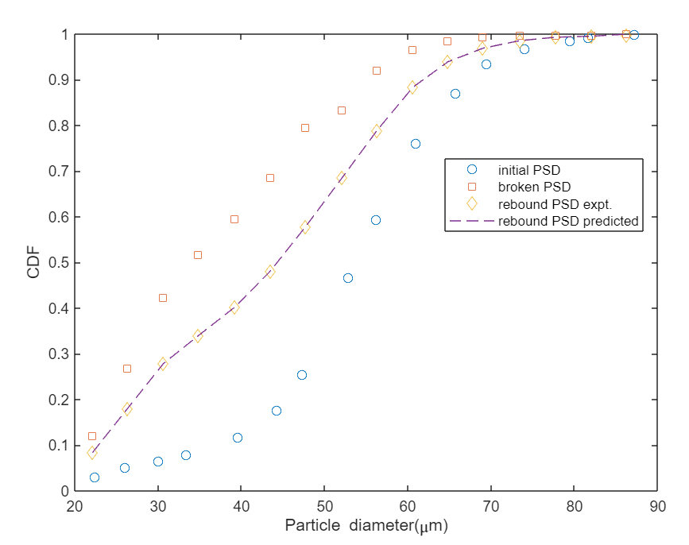
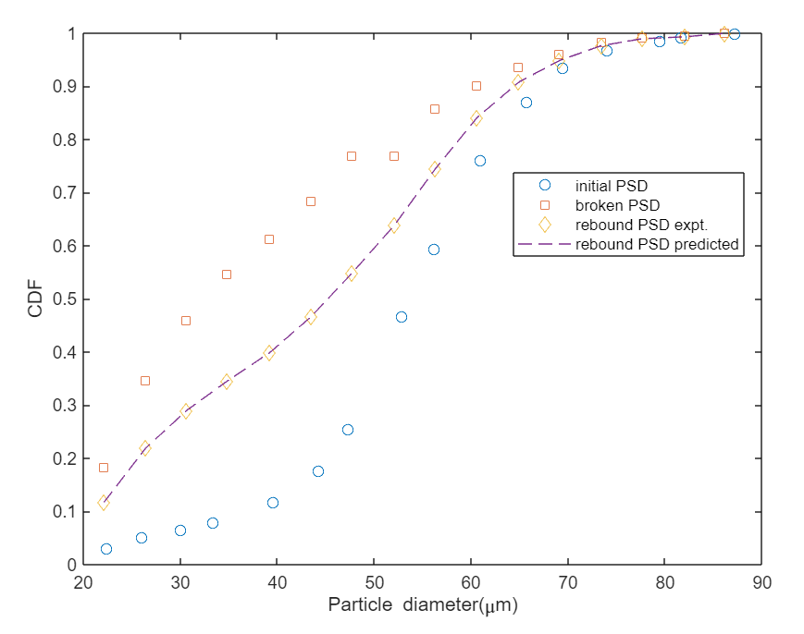
Results of predicted PSD
Speed OP2, angle 20 degrees
Speed OP2, angle 30 degrees

Slide 18
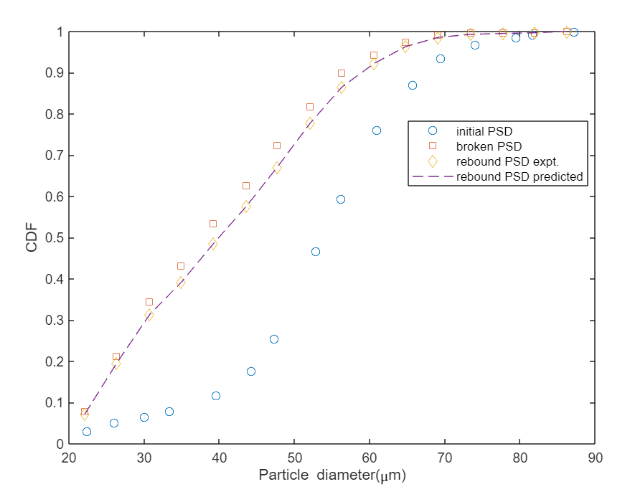
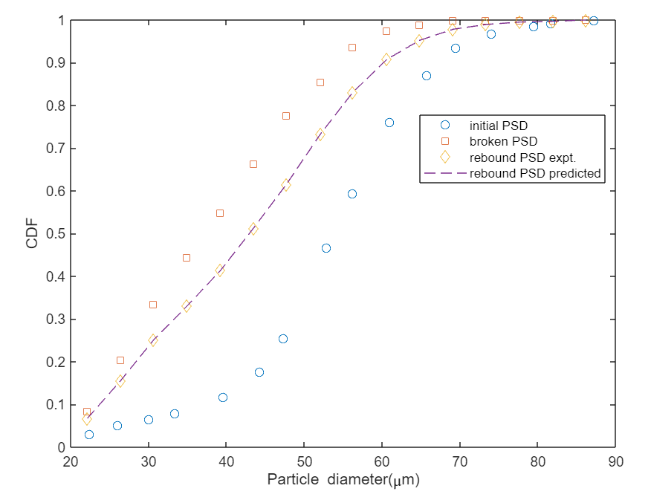
Results of predicted PSD
Speed OP2, angle 40 degrees
Speed OP2, angle 50 degrees

Slide 19
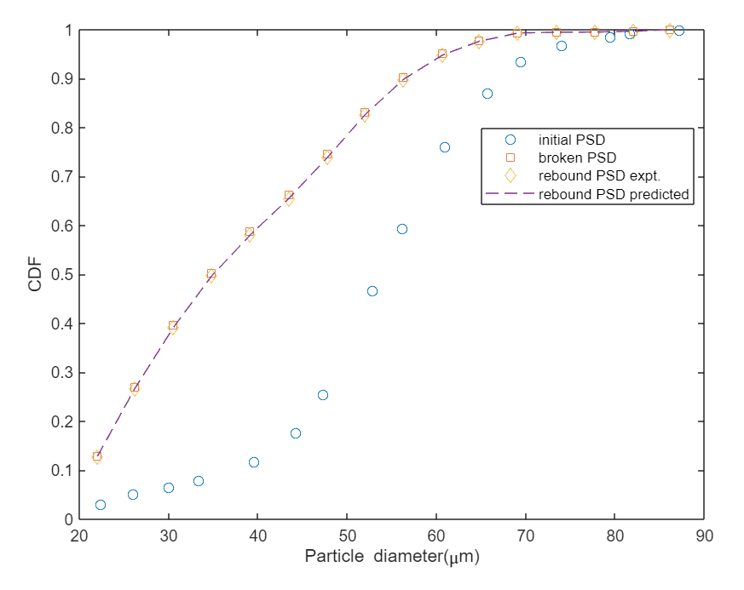
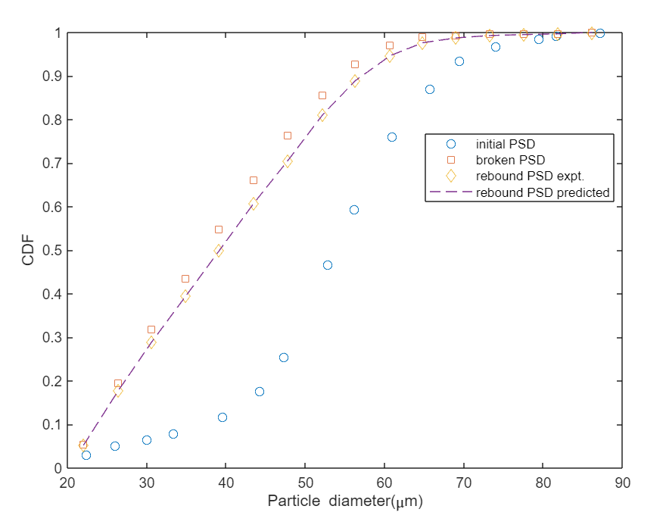
Results of predicted PSD
Speed OP2, angle 60 degrees
Speed OP2, angle 70 degrees

Slide 20
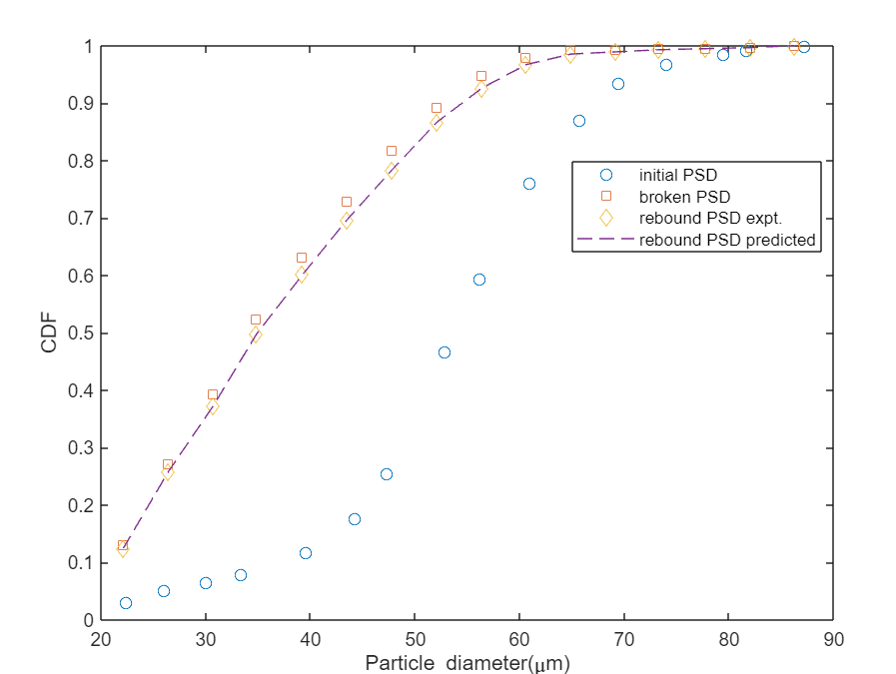
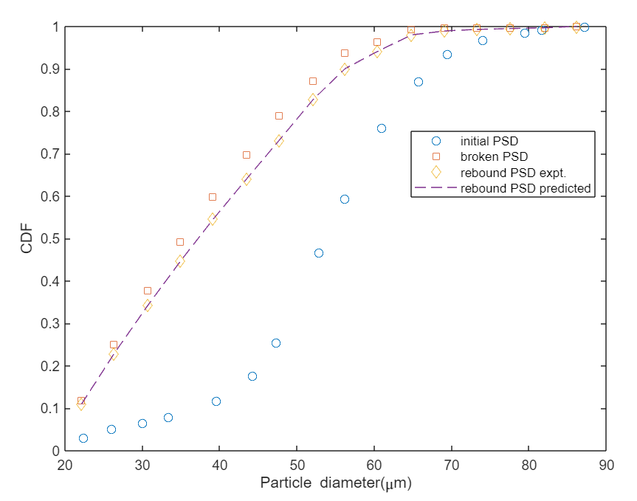
Results of predicted PSD
Speed OP2, angle 80 degrees
Speed OP2, angle 90 degrees

Slide 21
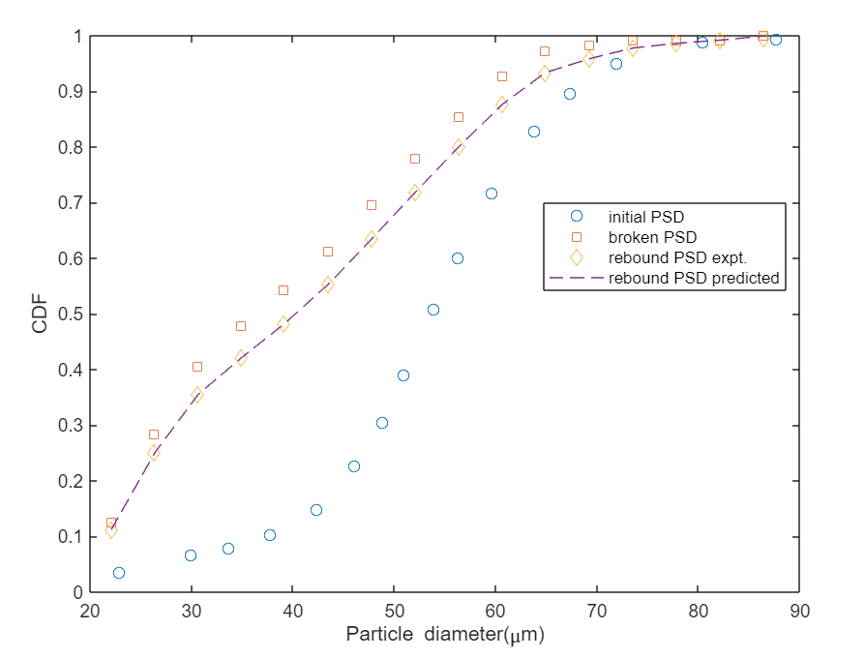
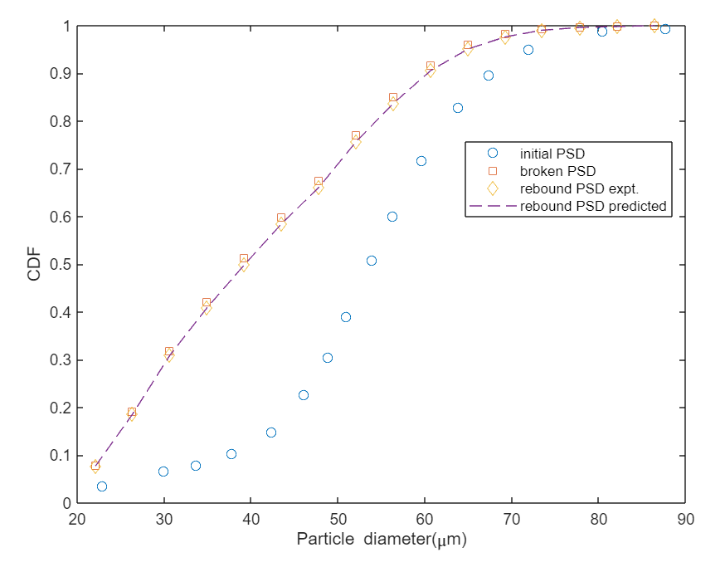
Results of predicted PSD
Speed OP3, angle 20 degrees
Speed OP3, angle 30 degrees

Slide 22
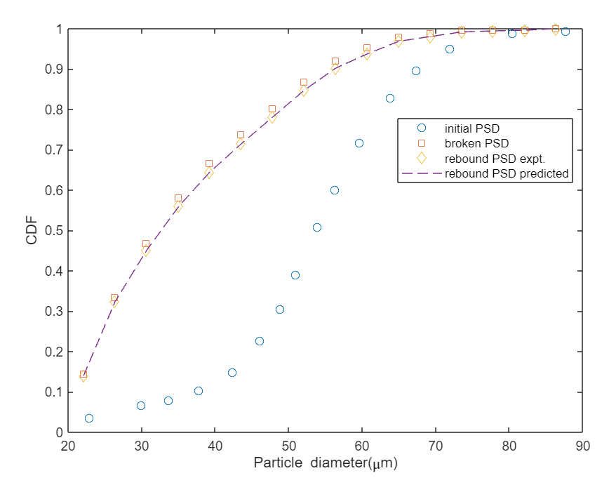
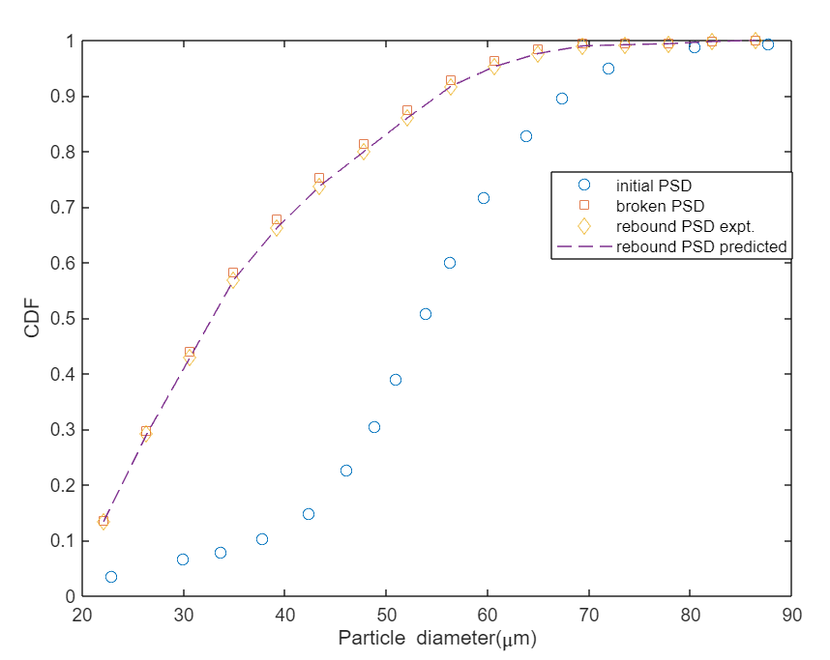
Results of predicted PSD
Speed OP3, angle 40 degrees
Speed OP3, angle 50 degrees

Slide 23
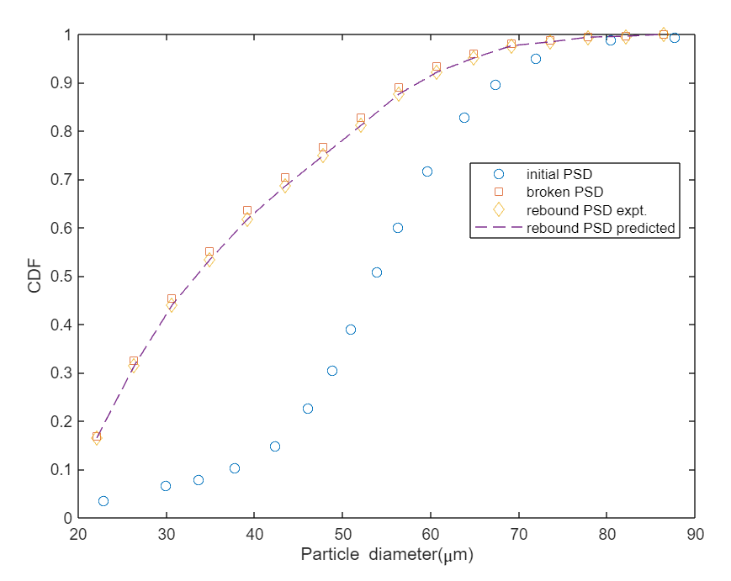
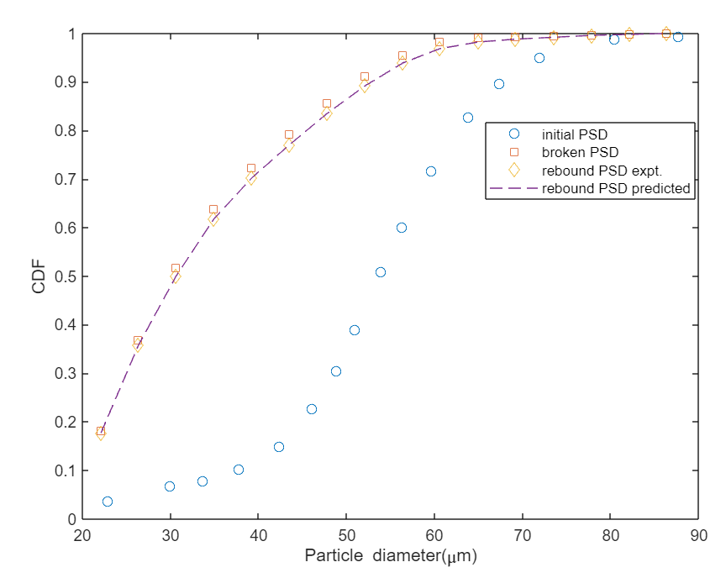
Results of predicted PSD
Speed OP3, angle 60 degrees
Speed OP3, angle 70 degrees

Slide 24
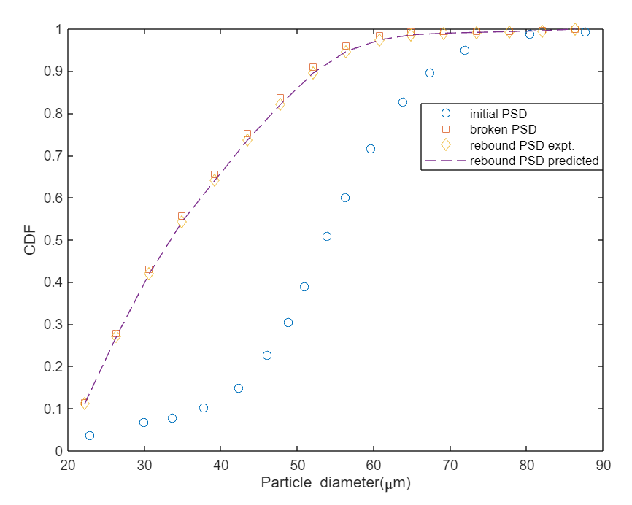
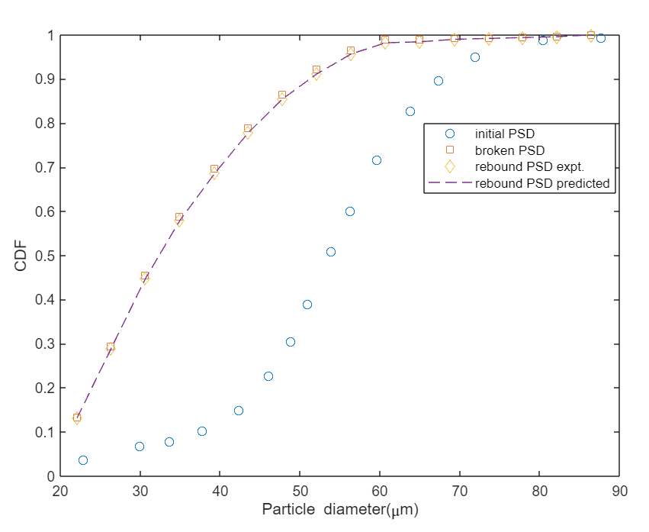
Results of predicted PSD
Speed OP3, angle 80 degrees
Speed OP3, angle 90 degrees

